Slide 1
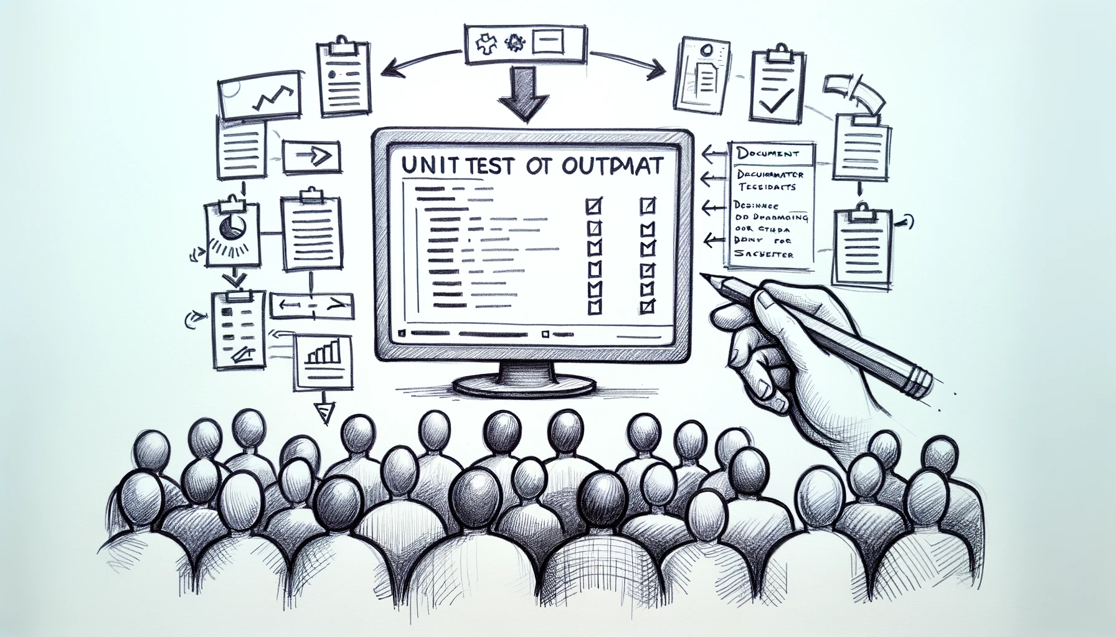
Better Testing with Approvals
Better Testing with ApprovalTests
Llewellyn Falco
Lada Kesseler
Llewellyn Falco
Lada Kesseler

Slide 2
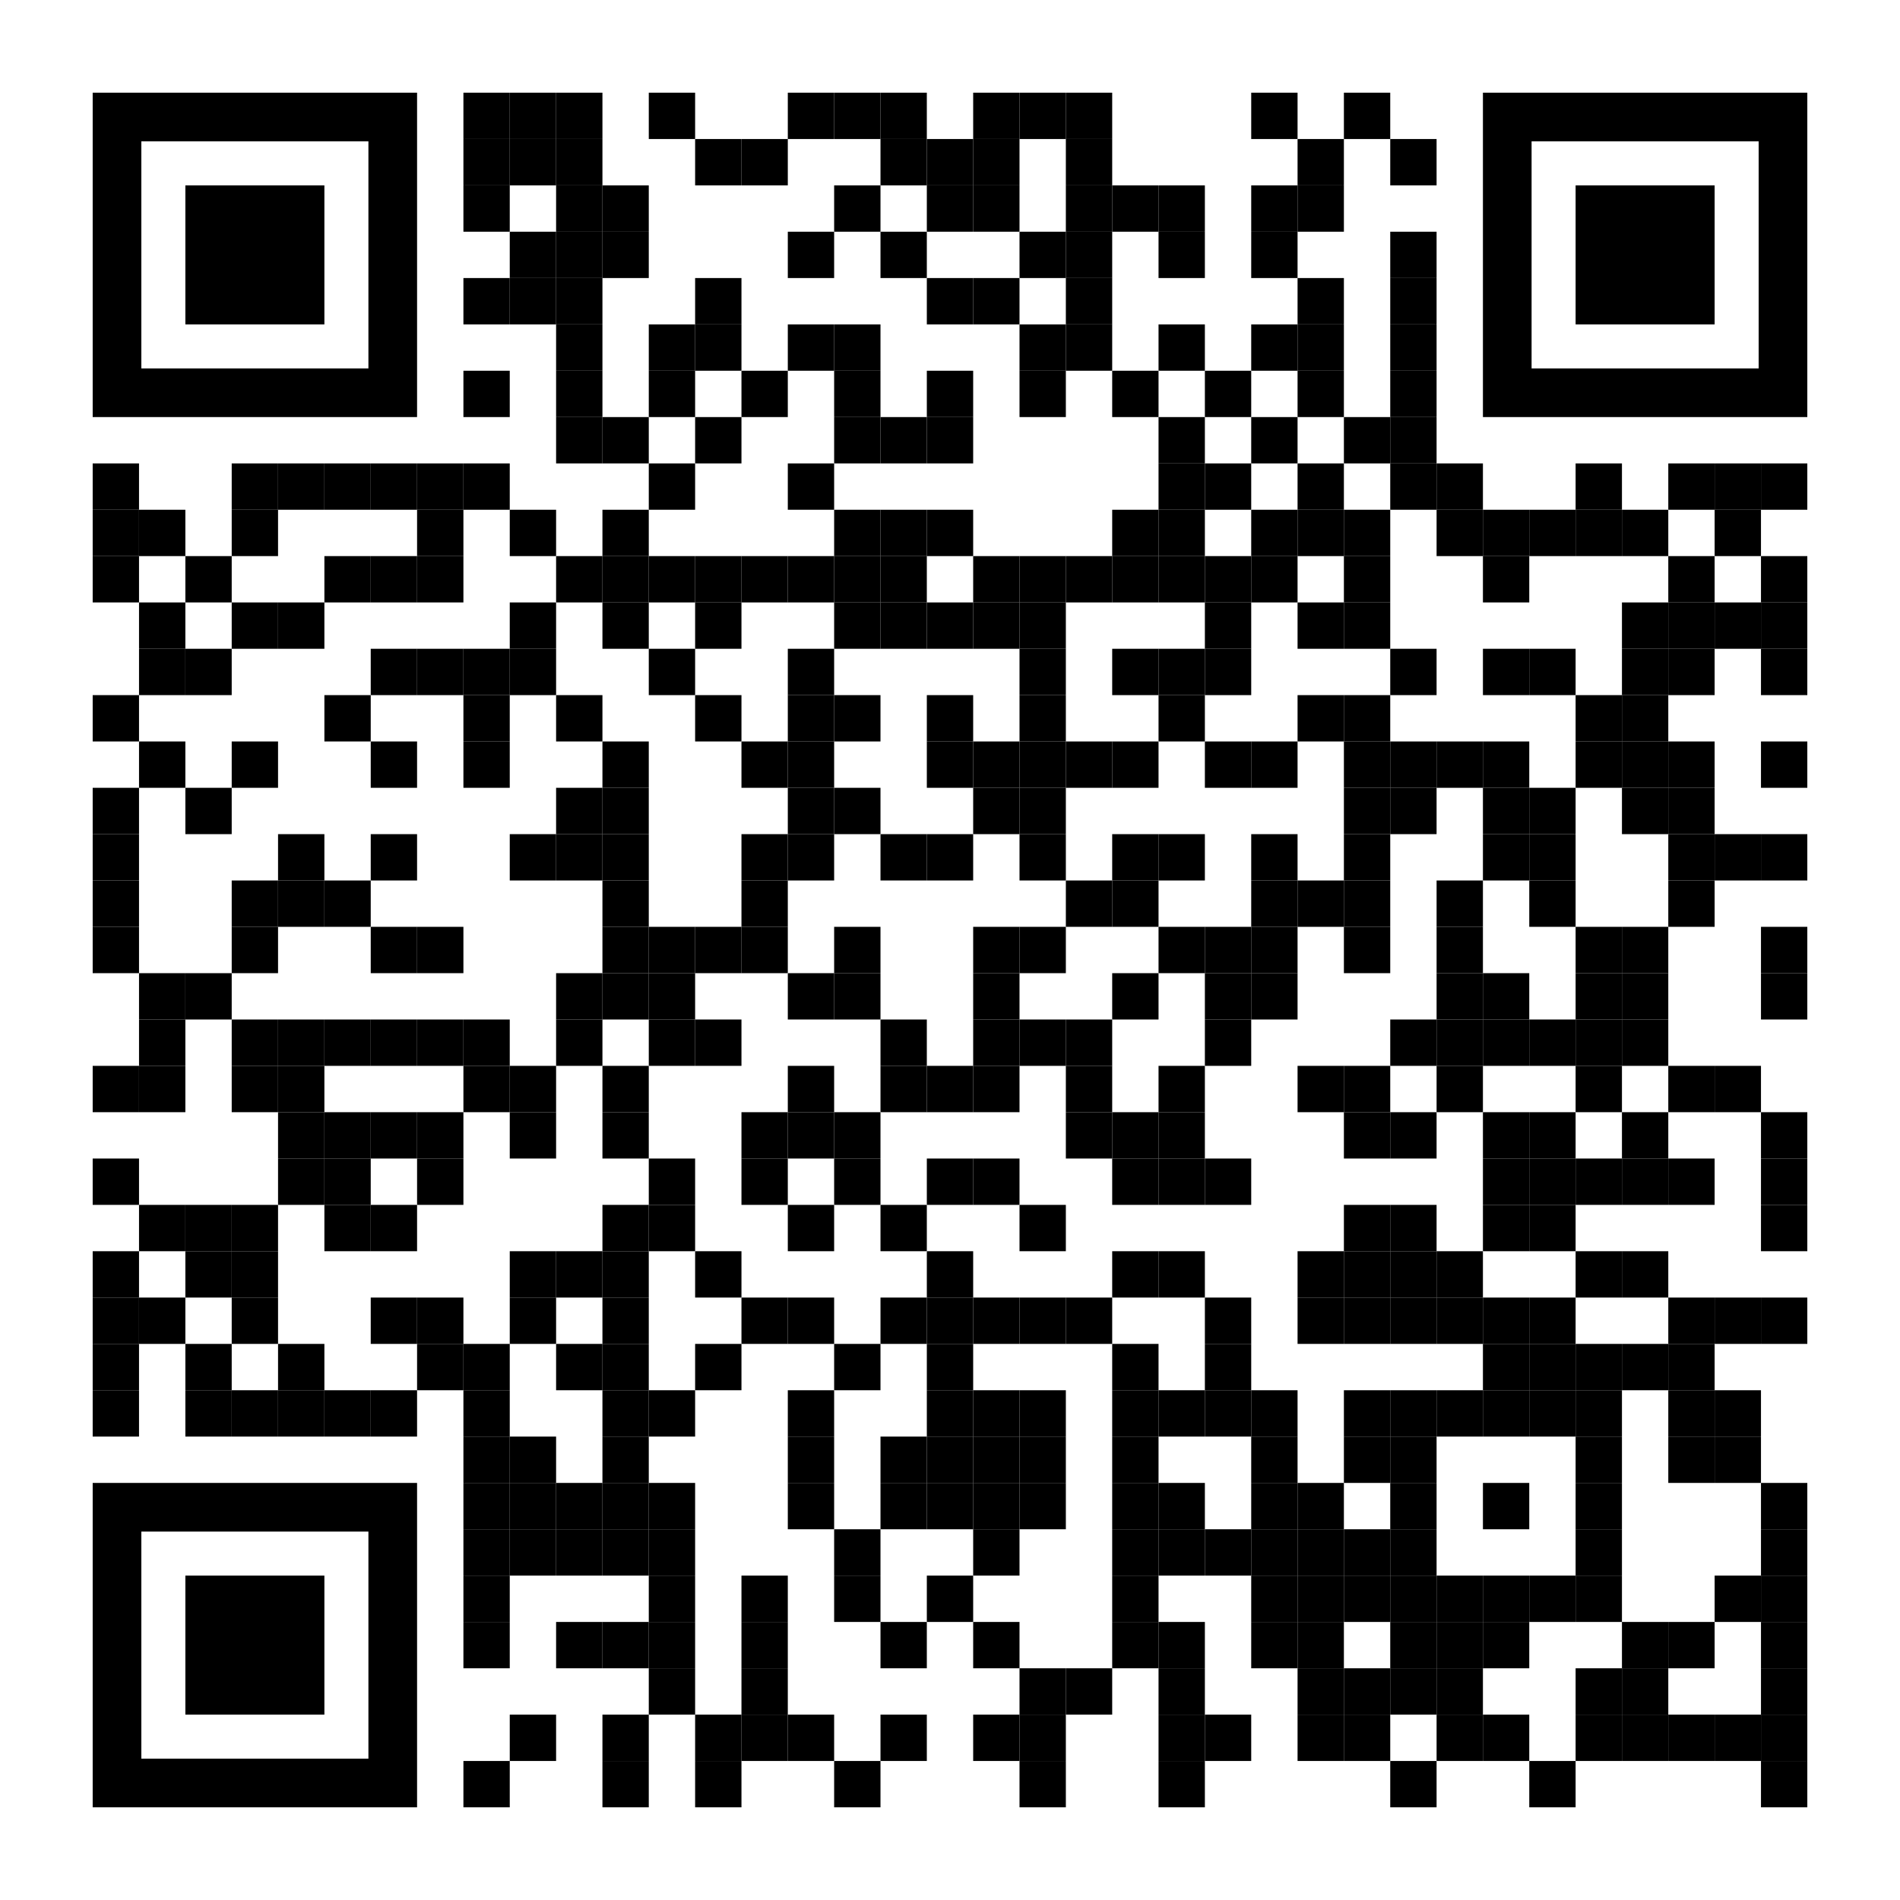
Resources
Notes:
https://github.com/isidore/Talks/blob/master/BetterTestingWithApprovals.md

Slide 3
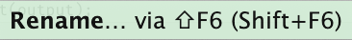
Housekeeping:
Presentation assistant

Slide 4

..
..
Clear
Expressive
Simple

Slide 5

In the beginning...

Slide 6
code

Slide 7
Problem:
What the test does is confusing

Slide 8
New Concept #1:
Testing Circle

Slide 9
// Create side (0,0) – (3,4)
// Verify length
Whiteboard
English
Testing Circle
Result
Code
Side (0,0) – (3,4) length = 5
Side s = new Side(0,0,3,4);
Approvals.Verify(s + “ length = “ +s.Length);

Slide 10
// Create side (0,0) – (3,4)
// Verify length
Whiteboard
English
Testing Circle
Result
Code
Side (0,0) – (3,4) length = 5
Side s = new Side(0,0,3,4);
Approvals.Verify(s + “ length = “ +s.Length);

Slide 11
// Create side (0,0) – (3,4)
// Verify length
Whiteboard
English
Testing Circle
Result
Code
Side (0,0) – (3,4) length = 5
Side s = new Side(0,0,3,4);
Approvals.Verify(s + “ length = “ +s.Length);

Slide 12
// Create side (0,0) – (3,4)
// Verify length
Whiteboard
English
Testing Circle
Result
Code
Side (0,0) – (3,4) length = 5
Side s = new Side(0,0,3,4);
Approvals.Verify(s + “ length = “ +s.Length);

Slide 13
// Create side (0,0) – (3,4)
// Verify length
Whiteboard
English
Testing Circle
Result
Code
Side (0,0) – (3,4) length = 5
Side s = new Side(0,0,3,4);
Approvals.Verify(s + “ length = “ +s.Length);

Slide 14
Chat
[Customer]
hi
[Bot]
Hi there! I'm your virtual assistant.
What would you like to do today?
Notes:
we put the focus on what it is that we're testing, and not the setup of the test

Slide 15
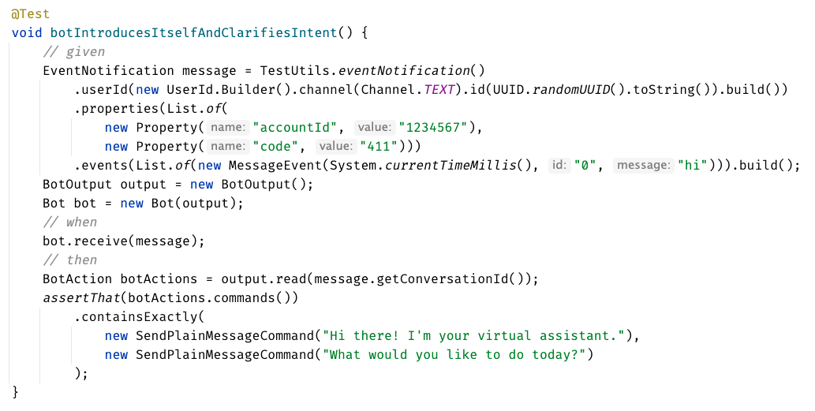

Slide 16
Chat
[Customer]
hi
[Bot]
Hi there! I'm your virtual assistant.
What would you like to do today?
Whiteboard
English
Testing Circle
Result
Code

Slide 17
Chat
[Customer]
hi
[Bot]
Hi there! I'm your virtual assistant.
What would you like to do today?
// customer says ‘hi’
// verify conversation
Whiteboard
English
Testing Circle
Result
Code

Slide 18
Chat
[Customer]
hi
[Bot]
Hi there! I'm your virtual assistant.
What would you like to do today?
// customer says ‘hi’
// verify conversation
Whiteboard
English
Testing Circle
Result
Code
String userMessage = "hi"; verifyConversation(userMessage);

Slide 19
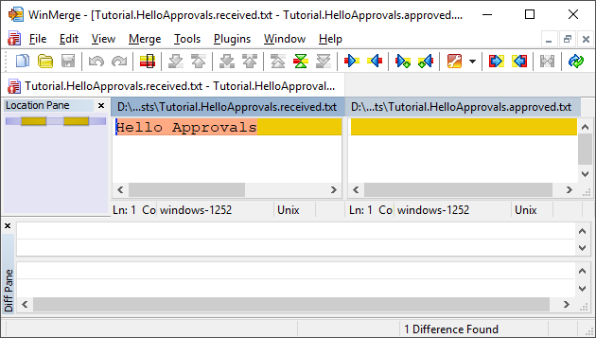
New Concept #2:
Approval Tests
Test + approved output

Slide 20
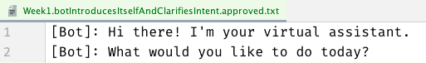
Chat
[Customer]
hi
[Bot]
Hi there! I'm your virtual assistant.
What would you like to do today?
// customer says ‘hi’
// verify conversation
Whiteboard
English
Testing Circle
Result
Code
String userMessage = "hi"; verifyConversation(userMessage);

Slide 21
Chat
[Customer]
hi
[Bot]
Hi there! I'm your virtual assistant.
What would you like to do today?
// customer says ‘hi’
// verify conversation
Whiteboard
English
Testing Circle
Result
Code
[Customer]: hi
String userMessage = "hi"; verifyConversation(userMessage);

Slide 22
Week 1
What happened
Notes:
Pay attention to the testing circle
Create convenience functions to hide unnecessary details

Slide 23
Complex
Tests
ApprovalTests
Testing Circle

Slide 25
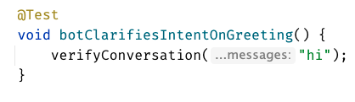
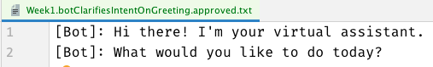

Slide 27
Week 1
learnings
Convenience Functions
ApprovalTests
Testing Circle
verifyConversation("hi");
Notes:
Pay attention to the testing circle
Create convenience functions to hide unnecessary details

Slide 28
...later next week...

Slide 29
code

Slide 30
Problem:
Lack of clarity in the test code output

Slide 31
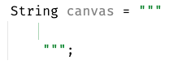
New Concept #3:
Story Board

Slide 32
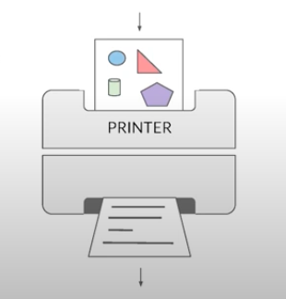
New Concept #4:
Printers
@EmillyBache

Slide 33
Chat
[Customer]
hi
[Bot]
Hi there! I'm your virtual assistant.
What would you like to do today?
[Customer]
pay bill
[Bot]
Are you a customer?
Yes, I'm a customer No, I'm not

Slide 34
[Customer]: hi [ Bot]: Hi there! I'm your virtual assistant. [ Bot]: What would you like to do today? [Customer]: pay bill [ Bot]: Let me try to help you. [ Bot]: { "content": { "type": "vertical", "elements": [ { "type": "text", "text": "Are you a customer?", "tooltip": "text tooltip" }, { "type": "horizontal", "elements": [ { "type": "button", "title": "Yes", "click": { "actions": [ { "type": "publishText", "text": "Yes, I'm a customer" } ] } }, { "type": "button", "title": "No", "click": { "actions": [ { "type": "publishText", "text": "No, I'm not" } ] } } ] } ] } }
Chat
[Customer]
hi
[Bot]
Hi there! I'm your virtual assistant.
What would you like to do today?
[Customer]
pay bill
[Bot]
Are you a customer?
Yes, I'm a customer No, I'm not

Slide 35
Week 2
What happened
Notes:
Pay attention to the testing circle
Create convenience functions to hide unnecessary details

Slide 36

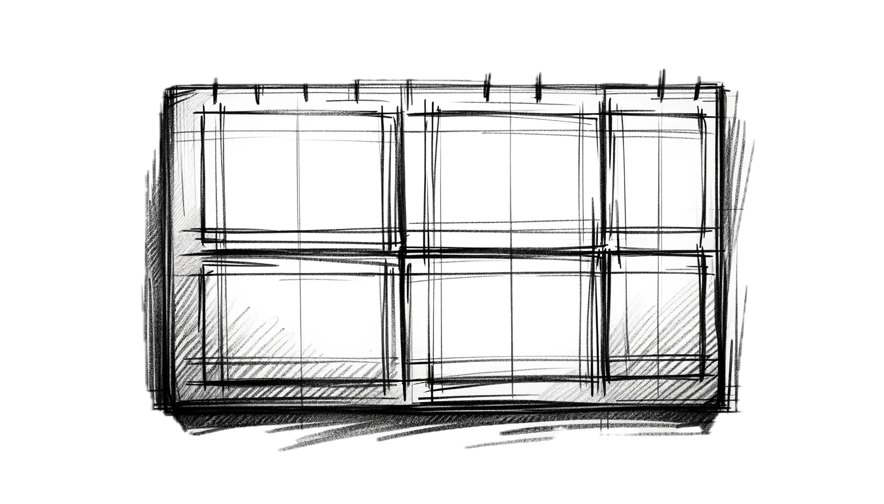
Complex
Tests
ApprovalTests
Testing Circle
Printers
+ Storyboard
JSON

Slide 37
Formatting
[Customer]: hi [Bot]: Hi there! I'm your virtual assistant. [Bot]: What would you like to do today?
[Customer]: hi [ Bot]: Hi there! I'm your virtual assistant. [ Bot]: What would you like to do today?

Slide 38
Formatting
[Customer]: hi [Bot]: Hi there! I'm your virtual assistant. [Bot]: What would you like to do today? [Customer]: hi [Bot]: Hmmm, tell me a little more so I can help you. What would you like to do today? [Customer]: hi [Bot]: Let me try to help you. [Bot]: Are you a customer? 1) Yes, I'm a customer 2) No, I'm not
[Customer]: hi
[ Bot]: Hi there! I'm your virtual assistant. [ Bot]: What would you like to do today? [Customer]: hi [ Bot]: Hmmm, tell me a little more so I can help you. [ ]: What would you like to do today? [Customer]: hi [ Bot]: Let me try to help you. [ Bot]: Are you a customer? [ ]: 1) Yes, I'm a customer [ ]: 2) No, I'm not

Slide 39
[Customer]: hi [ Bot]: Hi there! I'm your virtual assistant. [ Bot]: What would you like to do today? [Customer]: pay bill [ Bot]: Let me try to help you. [ Bot]: { "content": { "type": "vertical", "elements": [ { "type": "text", "text": "Are you a customer?", "tooltip": "text tooltip" }, { "type": "horizontal", "elements": [ { "type": "button", "title": "Yes", "click": { "actions": [ { "type": "publishText", "text": "Yes, I'm a customer" } ] } }, { "type": "button", "title": "No", "click": { "actions": [ { "type": "publishText", "text": "No, I'm not" } ] } } ] } ] } }
[Customer]: hi [ Bot]: Hi there! I'm your virtual assistant. [ Bot]: What would you like to do today? [Customer]: pay bill [ Bot]: Let me try to help you. [ Bot]: Are you a customer? [ ]: 1) Yes, I'm a customer [ ]: 2) No, I'm not

Slide 40
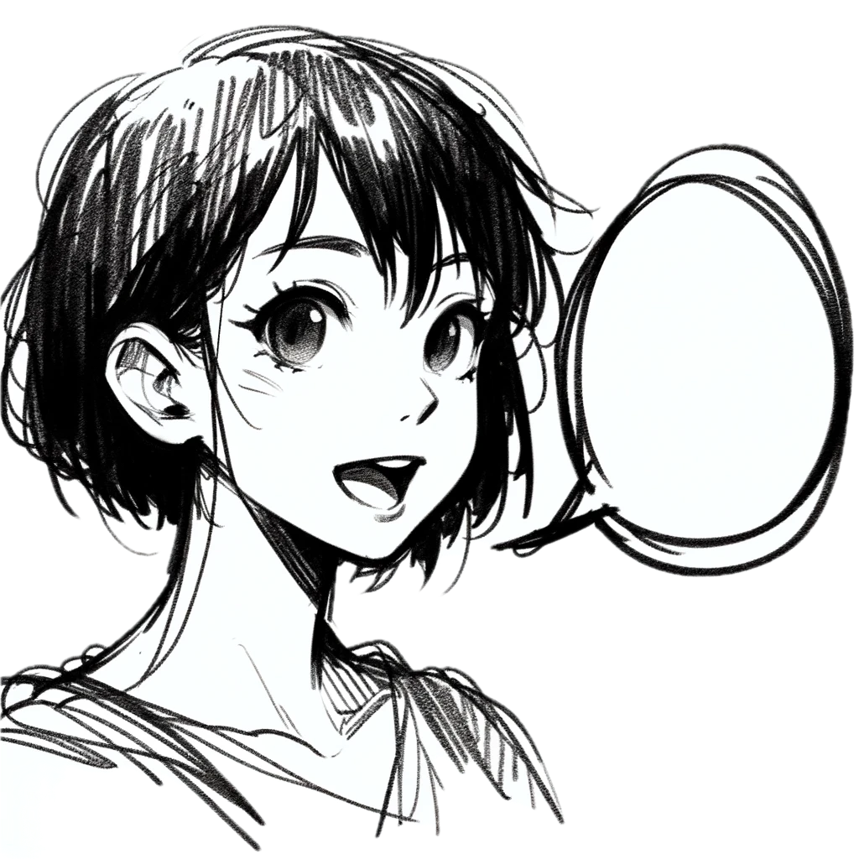
Week 2
learnings
Storytelling
Storyboard
Printers
Formatting
[Customer]: talk to an operator [ Bot]: Hi there! I'm your virtual assistant. [ Bot]: Let me try to help you. [ Bot]: Are you a customer? [ ]: 1) Yes, I'm a customer [ ]: 2) No, I'm not
Notes:
Pay attention to the testing circle
Create convenience functions to hide unnecessary details

Slide 41
...later next week...

Slide 42
code

Slide 43
Problem:
Too many .approved. files

Slide 44
New Concept #5:
Inline Approvals

Slide 45
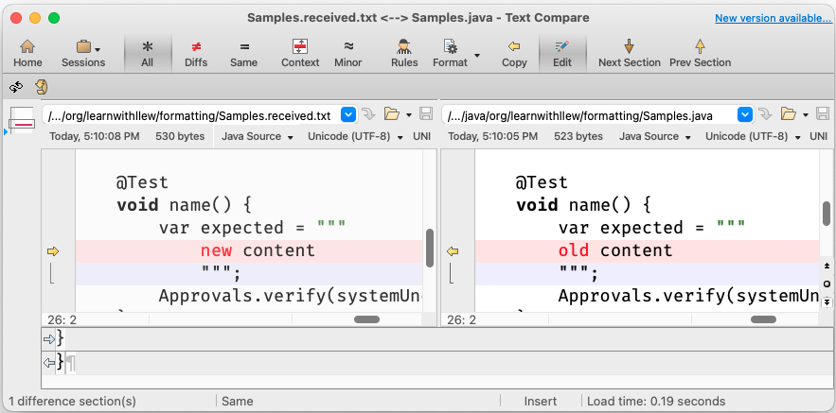
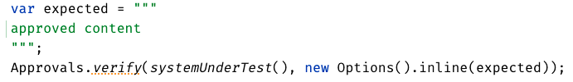
New Concept:
Inline Approvals
“Look mom, no files!”
Possible new source file
Original source file
Approved output
How to invoke
Pressing this modifies
your source code

Slide 46
Week 3
What happened
Notes:
Pay attention to the testing circle
Create convenience functions to hide unnecessary details

Slide 47
Complex
Tests
ApprovalTests
Testing Circle
Printers
+ Storyboard
JSON
Inline

Slide 48
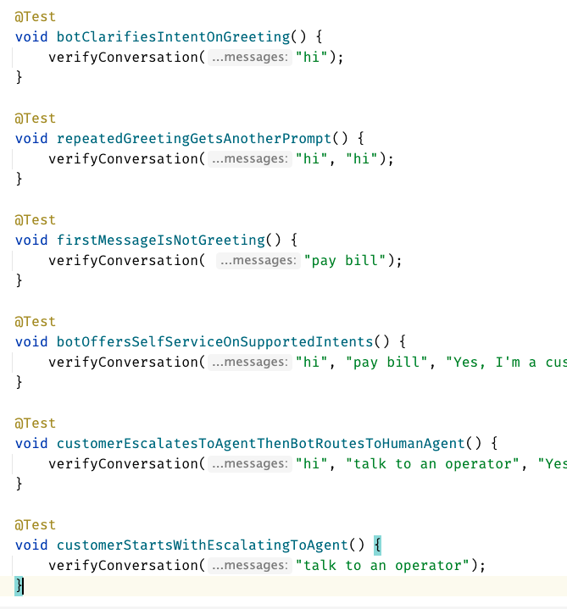
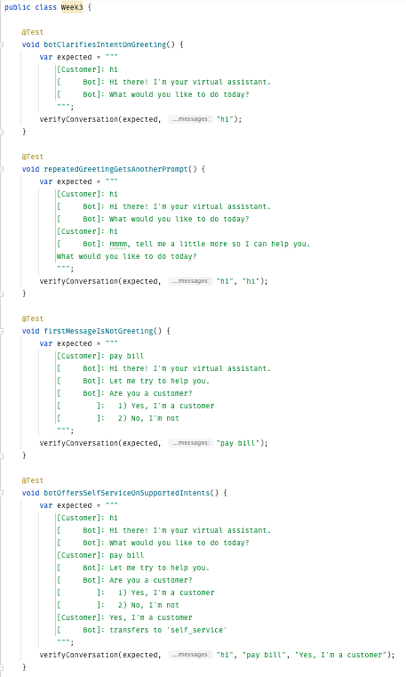
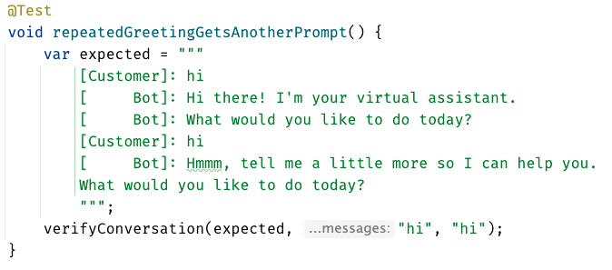
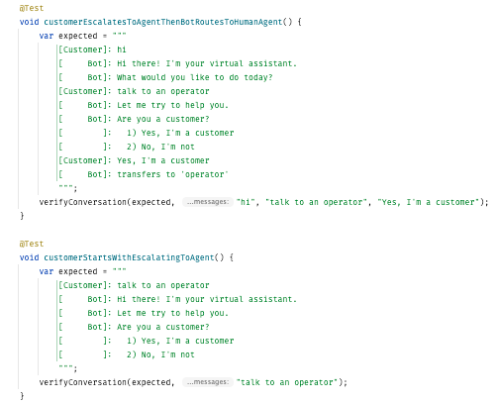
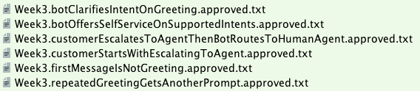

Slide 49
Week 3
learnings
Inline
Notes:
Pay attention to the testing circle
Create convenience functions to hide unnecessary details

Slide 50
...later next week...

Slide 51
code
Notes:
Hey Llewellyn, look what I did

Slide 52
Problem:
Can’t see the overall test strategy
hard to see if you’re missing cases...

Slide 53
New Concept #6:
verifyAll()

Slide 54
New Concept #7:
many of one

Slide 55
Week 4
What happened
Notes:
Pay attention to the testing circle
Create convenience functions to hide unnecessary details

Slide 56
Complex
Tests
ApprovalTests
Testing Circle
Printers
+ Storyboard
JSON
Verify all
Inline

Slide 57
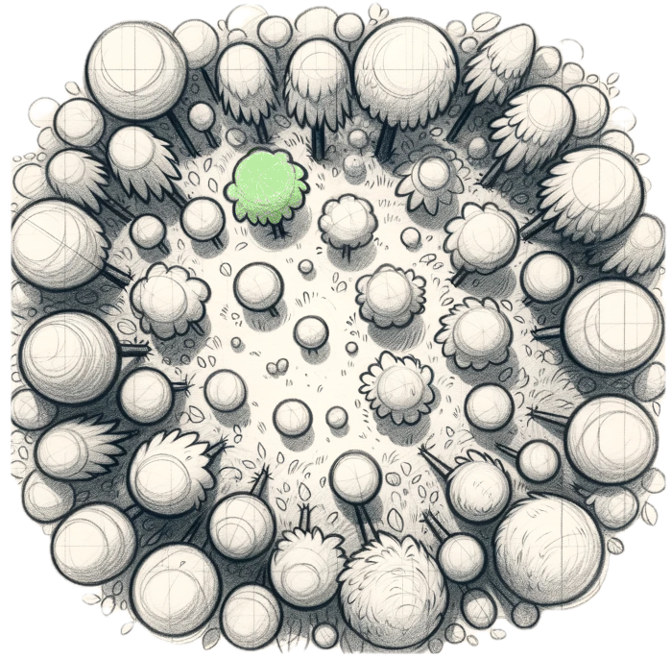
Week 4
learnings
Verify all
Printers
See the forest AND the trees
Notes:
Pay attention to the testing circle
Create convenience functions to hide unnecessary details

Slide 58
...later next week...

Slide 59
code
Notes:
Hey Llewellyn, look what I did

Slide 60
Problem:
95% of tests are together
but 5% are alone...

Slide 61
New Concept #8:
Custom test scenario builders
creating Domain-Specific Language (DSLs)

Slide 62
Week 5
What happened
Notes:
Pay attention to the testing circle
Create convenience functions to hide unnecessary details

Slide 63
Complex
Tests
ApprovalTests
Testing Circle
Printers
+ Storyboard
JSON
Verify all
Inline
Test Scenario DSL

Slide 64
var conversation1 = conversation("pay bill", "Yes, I'm a customer"); var conversation2 = conversation("pay bill"); var conversations = List.of(conversation1, conversation2);
conversation("pay bill", "No, I'm not") .thenConversation("pay bill")

Slide 65
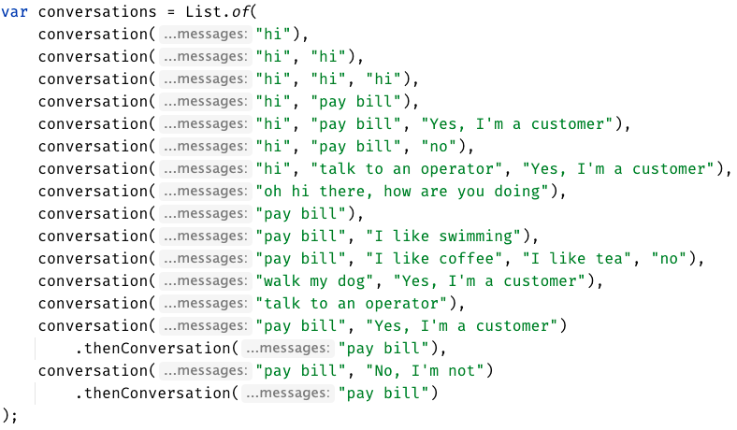

Slide 66
Week 5
learnings
See the forest AND the trees
(consistency)
Test Scenario DSL
Notes:
Invest in APIs that make it easier to express test scenarios

Slide 67
...later next week...

Slide 68
code
Notes:
Hey Llewellyn, look what I did

Slide 69
Problem:
The tests are only for developers

Slide 70
New Concept #9:
Alternative .approved. files
new Options().forFile().withExtension(".md")
Notes:
stakeholders

Slide 71
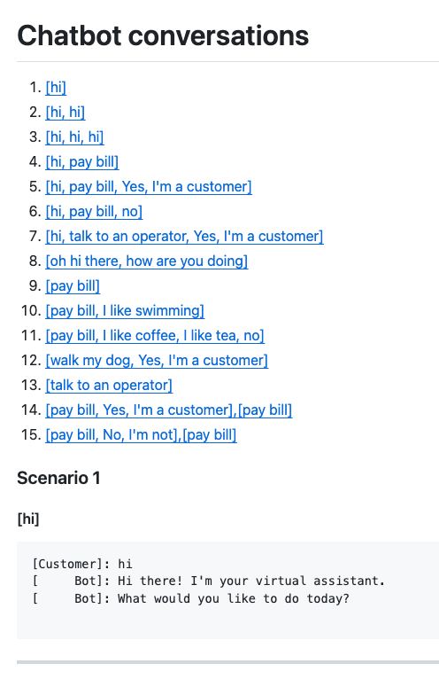
Complex
Tests
ApprovalTests
Testing Circle
Printers
+ Storyboard
markdown
Tests
work as Documentation
JSON
Verify all
Inline
Test Scenario DSL

Slide 72
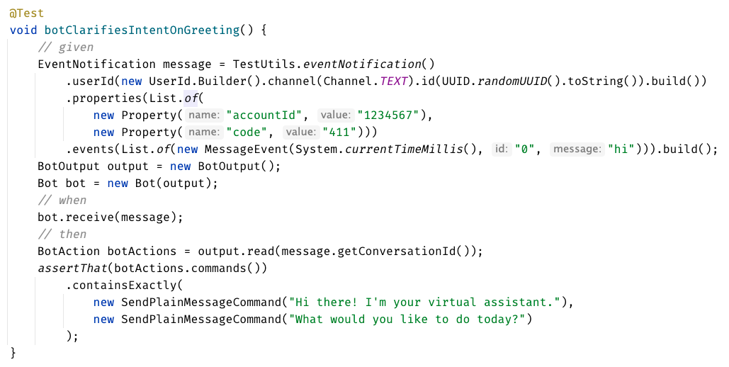
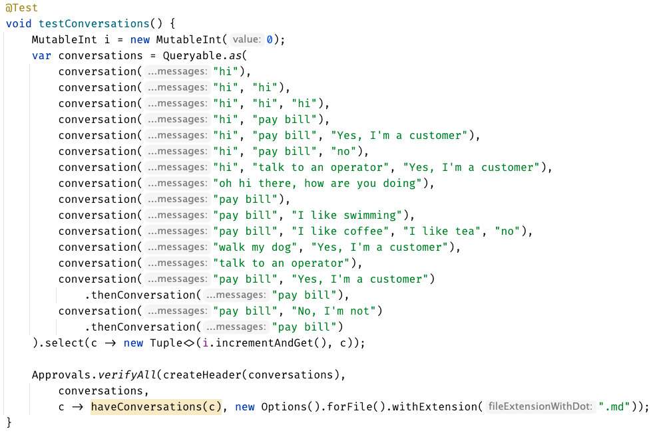

Slide 73
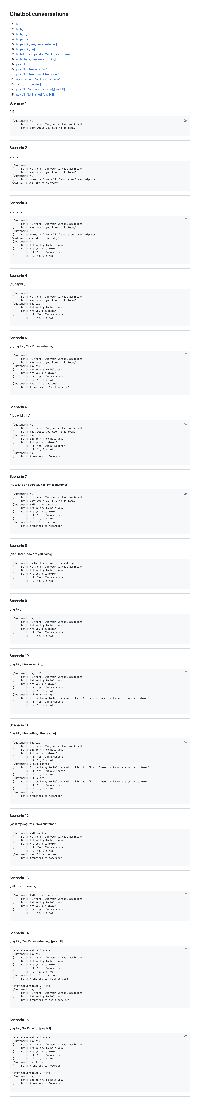

Slide 76
Concepts:
1. Testing Circle
2. Approval Tests
3. Story Board
4. Printers
5. Inline Approvals
6. verifyAll()
7. Many of one
8. Custom test scenario builders (DSL)
9. Alternative .approved. files (markdown)

Slide 77
learnings
Storyboard
ApprovalTests
Storytelling
Testing Circle
Printers
Inline
Convenience Functions
verifyConversation("hi");
Test Scenario DSL
See the forest AND the trees
Verify all
Markdown
Notes:
Pay attention to the testing circle
Create convenience functions to hide unnecessary details

Slide 78
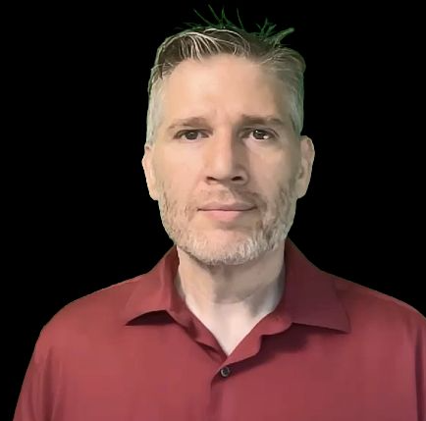
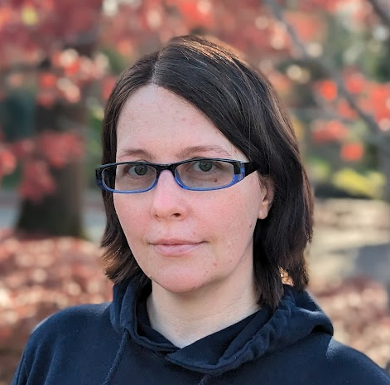
Resources
Thank you!
Llewellyn Falco
Lada Kesseler
Please connect on LinkedIn
Notes:
https://github.com/isidore/Talks/blob/master/BetterTestingWithApprovals.md

Slide 79
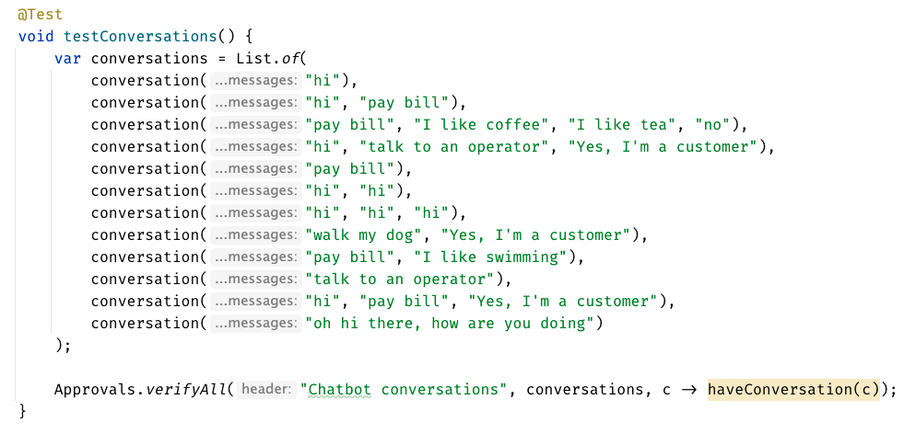

Slide 80
Chat
[Customer]
hi
[Bot]
Hi there! I'm your virtual assistant.
What would you like to do today?
Whiteboard
English
Testing Circle
Result
Code

Slide 81
Test.approved.txt
[Bot]: Hi there! I'm your virtual assistant. [Bot]: What would you like to do today?
Test.approved.txt
[Customer]: hi
[ Bot]: Hi there! I'm your virtual assistant. [ Bot]: What would you like to do today?

Slide 82
var expected = """ [Customer]: hi [ Bot]: Hi there! I'm your virtual assistant. [ Bot]: What would you like to do today? """; verifyConversations(expected, "hi");

Slide 83
var conversations = List.of( conversation("hi"), conversation("hi", "hi"), conversation("hi", "hi", "hi"), conversation("hi", "pay bill"), conversation("hi", "pay bill", "Yes, I'm a customer"), conversation("hi", "pay bill", "no"), conversation("hi", "talk to an operator", "Yes, I'm a customer"), conversation("oh hi there, how are you doing"), conversation("pay bill"), conversation("pay bill", "I like swimming"), conversation("pay bill", "I like coffee", "I like tea", "no"), conversation("walk my dog", "Yes, I'm a customer"), conversation("talk to an operator") );
conversation("pay bill", "No, I'm not") .thenConversation("pay bill")

